Slide 1


Sales Project Team 2
Global Super Store Orders 2016 (Data set )

Slide 2
Project Targets
Achievements
Achieving the aimed point with a summarized Dashboard & the related insights
Analyzing
Analyzing & Modeling all sales strength points
Data cleaning
Cleaning & Transforming

Slide 3
Team Members
1- Ahmed Saeed Abdel-Aleem Mohamed .
2- Mohamed Ahmed Amin Samy Zaglol .
3- Mohamed Hassan Abostait .
4- Ahmed Amr Ibrahim Attia.
5- Abdelrahman Mahmoud Taha Muhammad .

Slide 4
Applied steps
1- Fetched the full dataset with 51290 rows instead of 9800 rows in the summarized dataset.
2- Imported dataset to Microsoft Power BI from the XLSX dataset file.
3- Cleansed the data using power query editor.
4- Extracted Brand Name, Order Lead time & the date breakdown (Year, Quarter, Month).
5- Created relationships between the fact table & dimension tables.
6- Grouped the related data columns into one group.
7- Created some measures to provide overall facts & statistics about the store & its performance.
8- Created separate pages for each analytics area ( Time Intelligence, Ship Mode, State, City, Order Lead Time, Customers & Segments, Brands, Product Categories & Sub-categories,.....).
9- Created the visuals related to each area of analytics to provide the suitable insights.
10- Formatted the visuals.
11- Summarized the findings & provided the recommendations from our point of view.
12- Created the Main Dashboard.

Slide 5
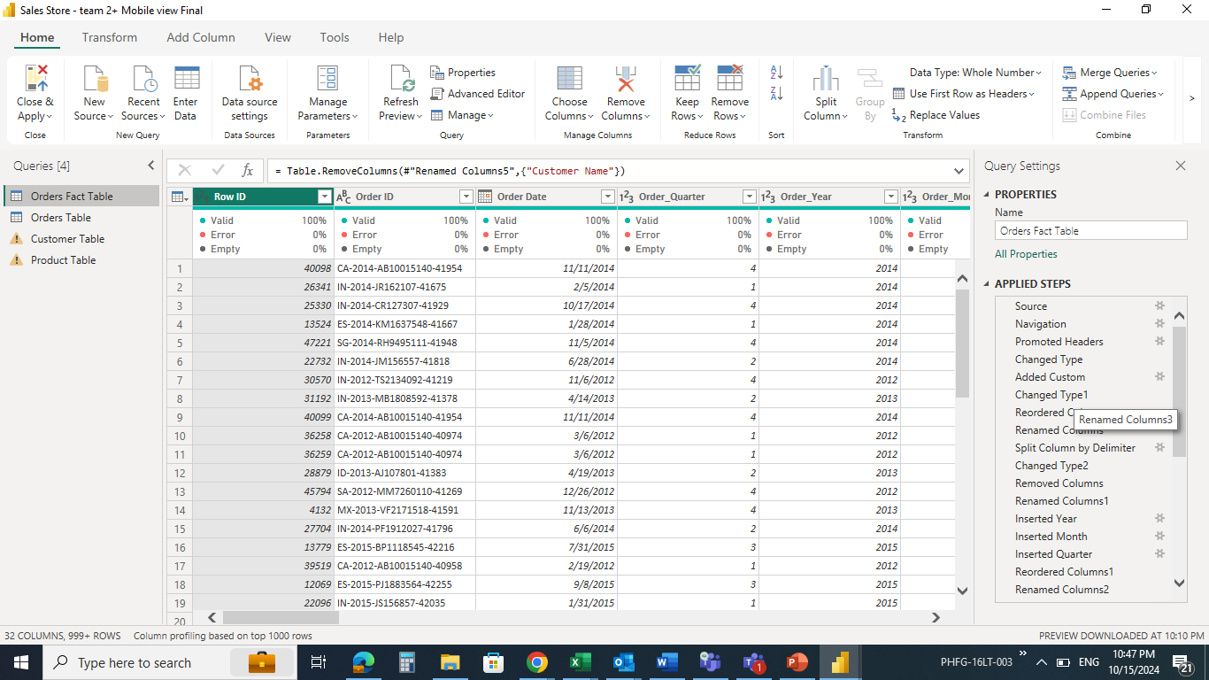
Data Cleaning and transforming

Slide 6
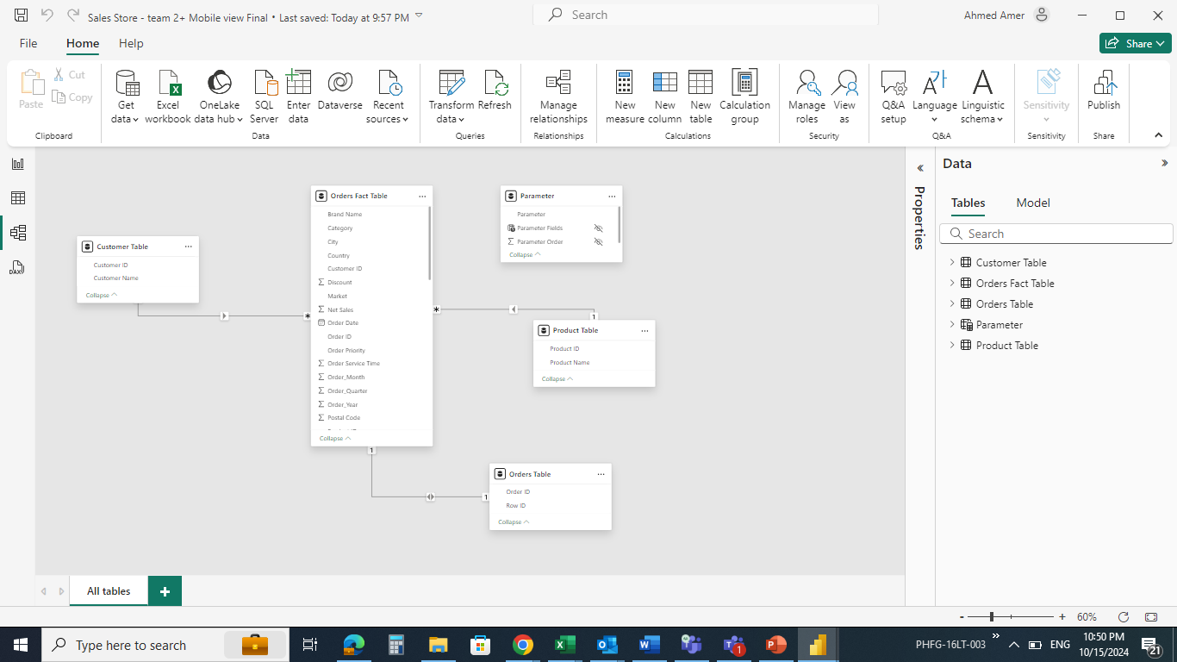
Data Modeling

Slide 7
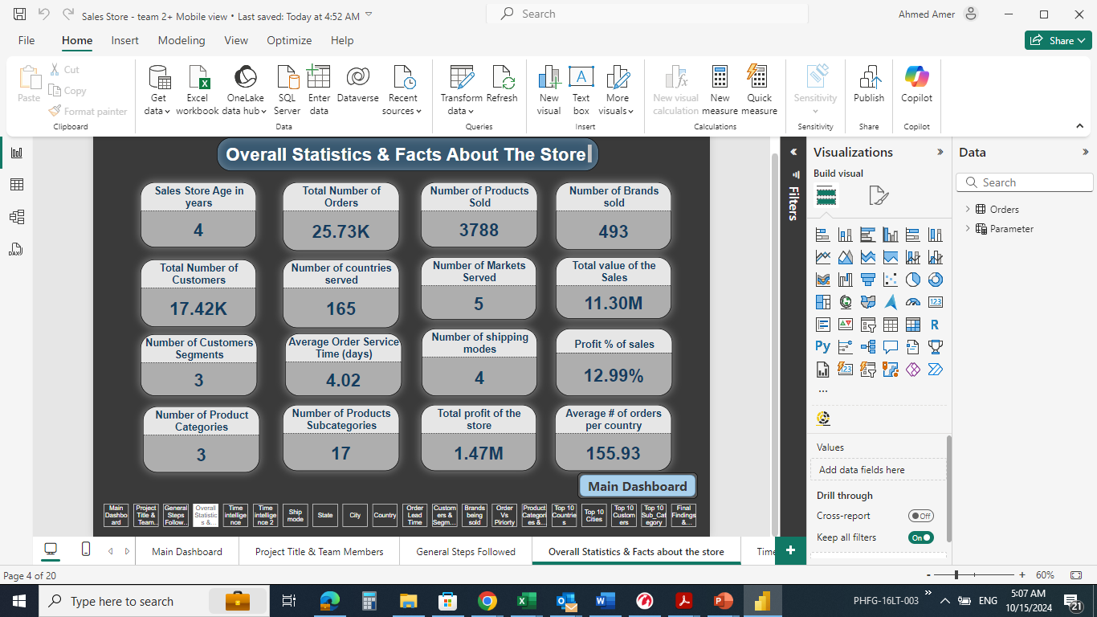
Over View statistics & Facts

Slide 8
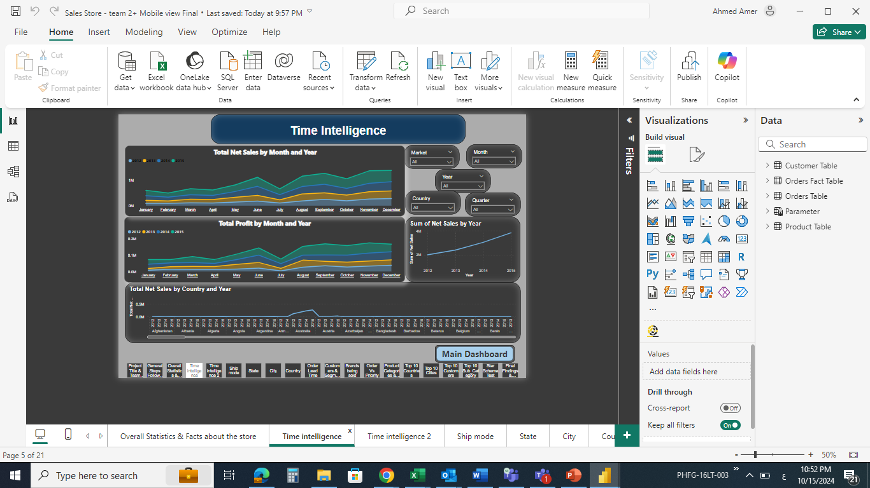
Insights of time intelligence

Slide 9
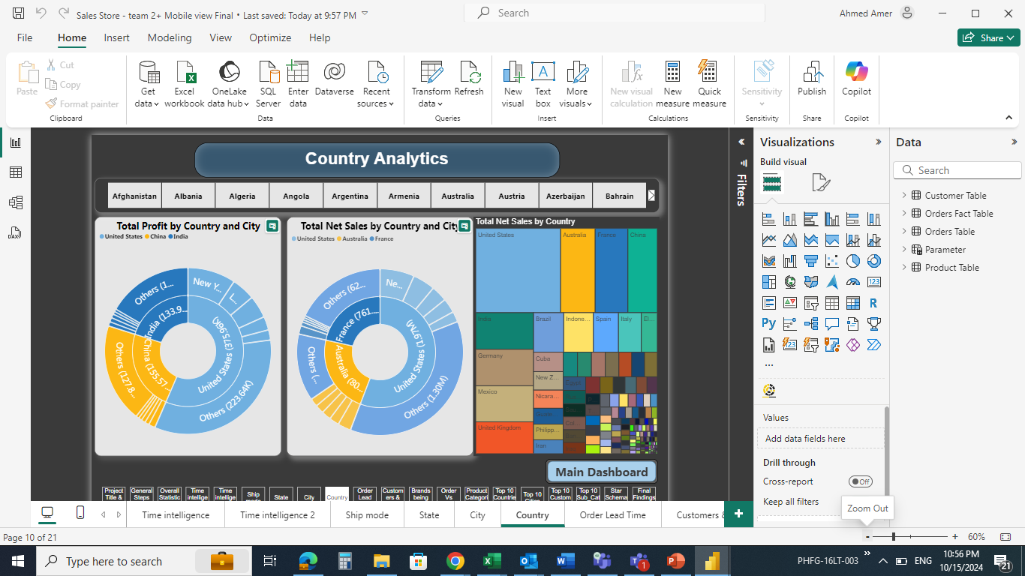
Country sales Insights

Slide 10
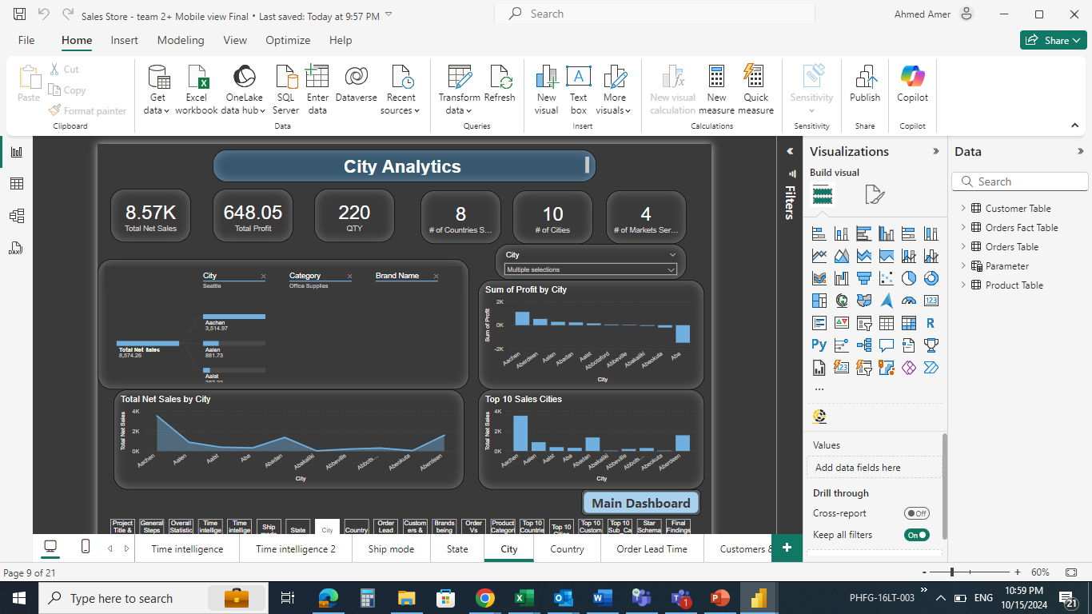
City Sales insights

Slide 11
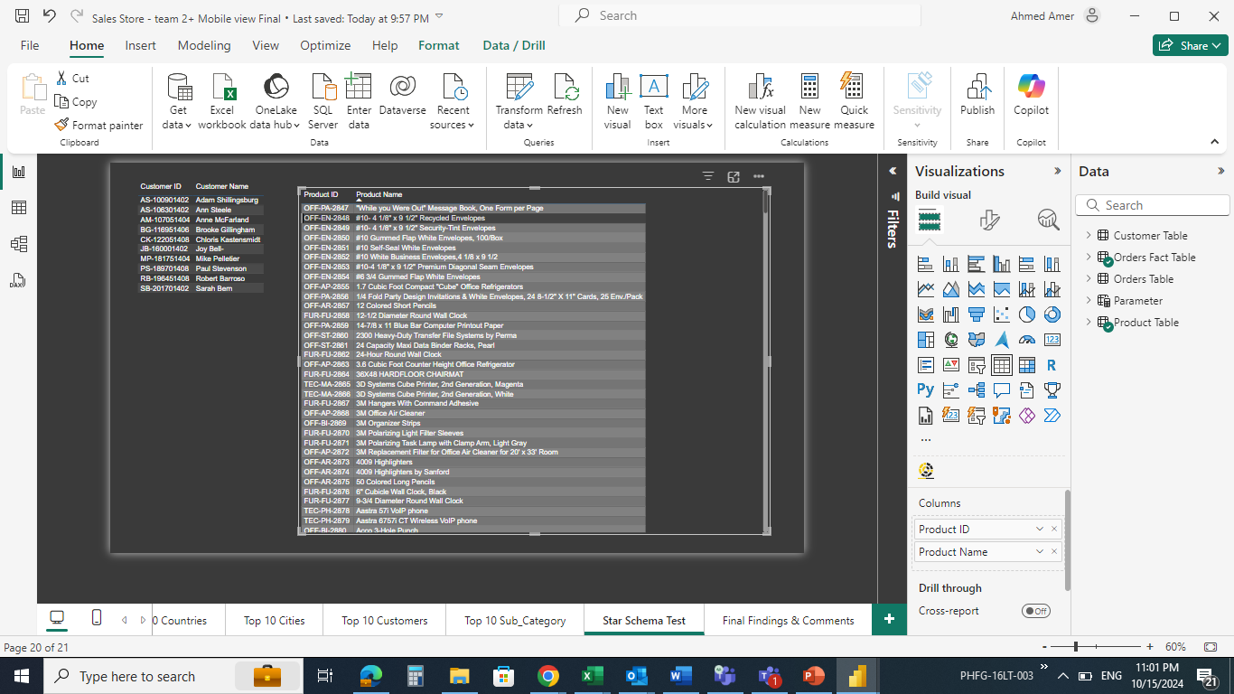
Star Schema Test

Slide 12
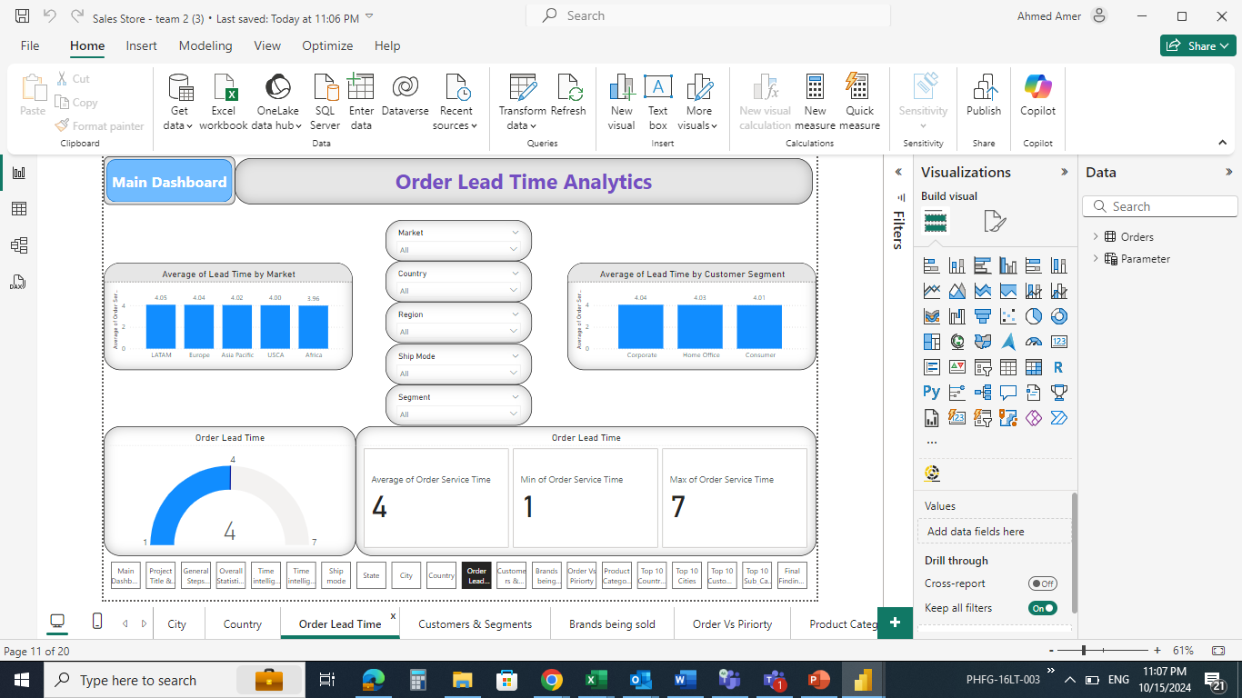
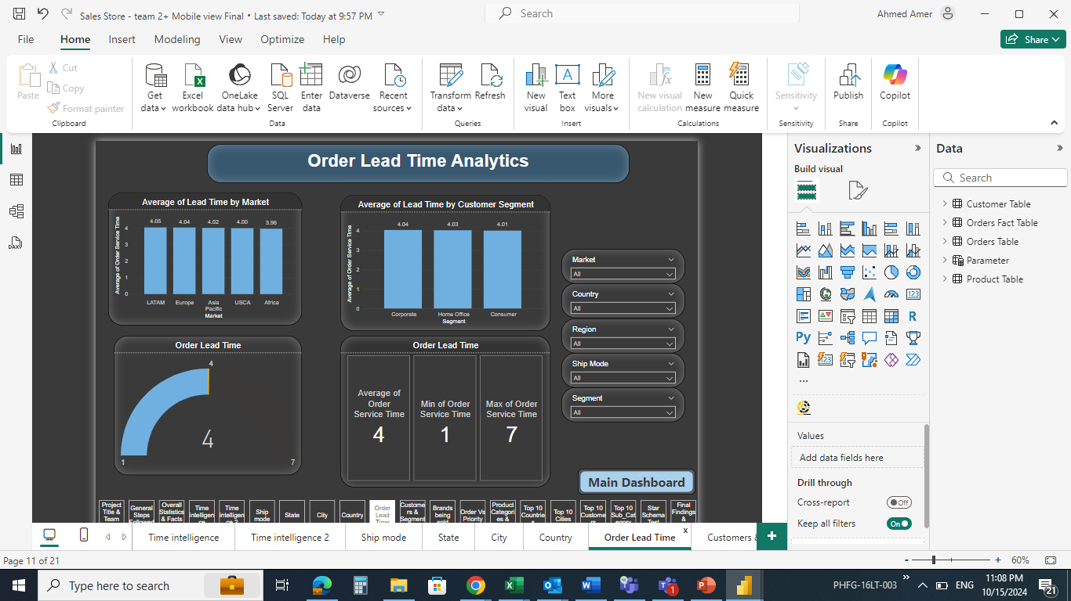
Styling insights

Slide 13
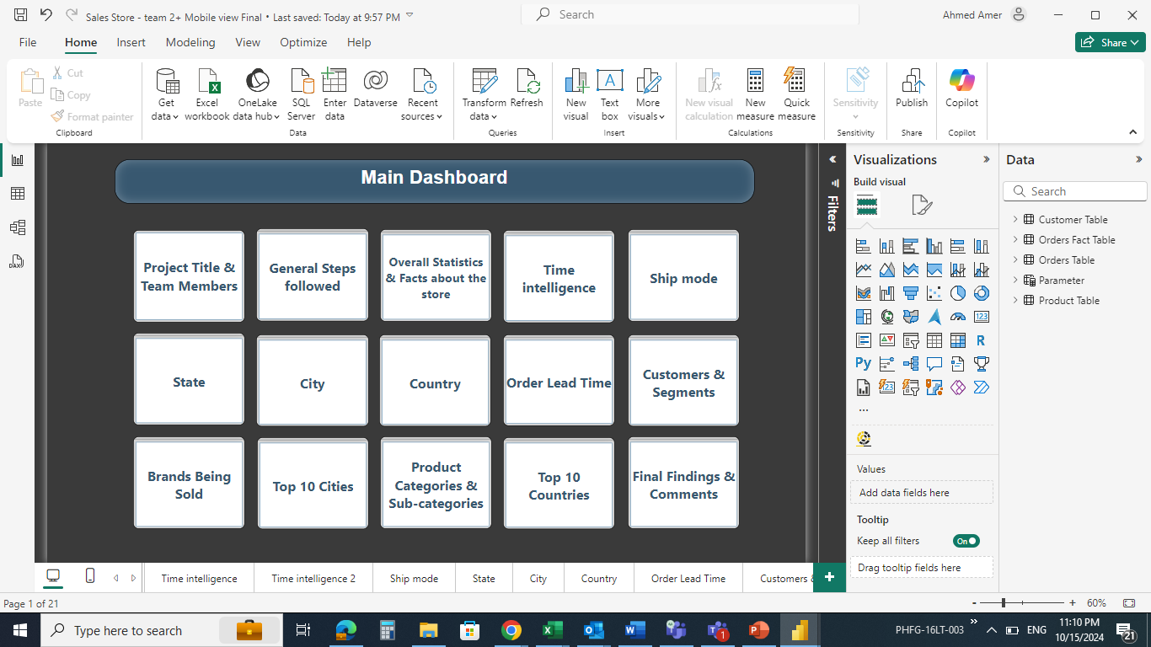
Main Dashboard

Slide 14
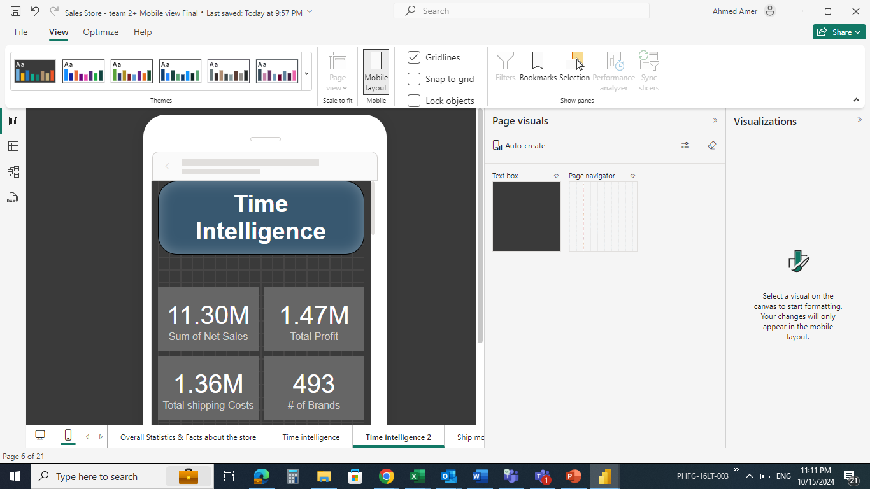
Mobile Layout view creation

Slide 15
Summarized Findings & Proposed Improvements
Insights Category | Related Tab | Insights
Areas of Excellence: | Time Intelligence | 1- Fast growing startup with an average 25% annual increase in sales volume.
 | Time Intelligence | 2- The sales & profit values hit the peak in the last quarter of each year.
 | Order Lead time | 3- Strong logistics & supply chain team, as the average lead time for different geographical areas is approximately the same (4 days).
Areas of Prospective Improvements: | Product Category & Sub-category | 1- The store shall automate the selling process of the office supplies & provide more focus on hiring salespersons with technological background to well manage the highest cashflow of the company.
 | Product Category & Sub-category | 2- Repricing & Cost restructure of technological products to increase the profitability % of this highest cash flow value.
 | Brands being Sold | 3- Meeting shall be held with the sales & Marketing teams to discuss the reason why 91% of the brands are only sold in one Market USCA & the possibility to expand to new markets.
 | Time Intelligence | 4- Offers shall be made in the 1st quarter of each year, as the sales & profit values hit the lowest points.
 | Data Cleansing | 5- Many Customers have the same 1st & 2nd names, so the name length shall be extended up to the 4th customer name.
 | Data Cleansing | 6- This store shall segregate the product brand name in a separate column to facilitate analytics using brand name.
 | Time Intelligence | 7- The profit in "Africa" Market hits the bottom or even turns negative at the end of each year which requires further discussion & analysis with the sales & marketing teams to reach the root cause & propose solutions.
General Insights | - | 1- Most Customers are located in the second-class ship mode.
 | - | 2- All 5 Markets served by the store purchase all product categories.
 | - | 3- The highest sales value is made by selling mobile phones.
 | - | 4- Most of the brands can be sold directly to end users, which shows that this store is more "B2C" oriented than "B2B".

Slide 16
Thanks

